Slide 1

Team Details
Team name: Vision AI
Team leader name: Himanshu Ghanshyam Kejdiwal
Problem Statement: Open Innovation(Social Impact)

Slide 2


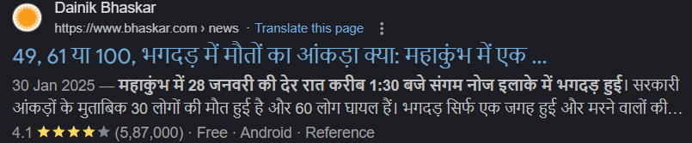
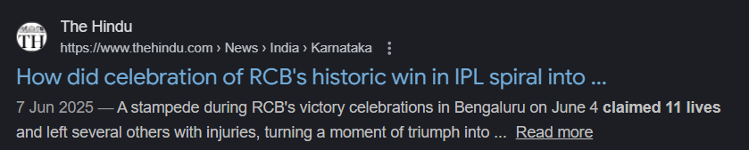
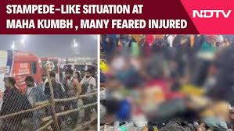
Problem Description & Solution
Problem Statement
Solutions
Large crowded events such as Maha Kumbh, parades, and rallies often suffer from poor crowd management, leading to overcrowding, stampedes, injuries, and loss of life. To address this, develop a crowd management and tracking platform will be using Google tools and full-stack web technologies to provide real-time guidance and monitoring for attendees.
Real-Time Crowd Monitoring: Live heatmaps and density tracking using user location data.
Intelligent Safety Routing: Dynamic navigation that guides attendees along the safest and fastest paths, not just the shortest.
Digital Command Center: A comprehensive dashboard for organizers to monitor the entire event layout live.
Emergency Response System: Instant SOS alerts and broadcast notifications to guide crowds to safety.

Slide 3


Solution Approach
Uniqueness of Solution
Solution Approach
Feature | Google Maps | Cevent | Crowd-Safe
Navigation | Public road |  | Venue Micro-Routing
Routing priority | Fastest time |  | According to crowd
Real time Safety | Traffic only |  | Live heatmaps
User Focus | Driver | Ticket buyer | attendee
1. Continuous Field Monitoring : It tracks where people are gathering in real-time to create a live, dynamic picture of the entire venue.
2. Predictive Hazard Detection: It analyzes crowd density patterns to flag overcrowding risks before they become dangerous.
3. Safety-First Navigation: Our approach prioritizes safety.
4. Proactive Loop It’s a two-way street. Event Organizers get a bird's-eye view to manage the flow, while Attendees receive instant updates.
Future Scope
Send Location based messages to device
Implement Calls & email notification for Emergency SOS
Vision (Camera)Based Crowd Detection System
AI based Path advisor to users
Note -: Crowd-Safe is unique because it democratizes safety data, giving attendees the power to make safer decisions in real-time.

Slide 4


Unique Solutions
Features of Platform
Real-Time Navigation
Multilingual support
General Feature
Attendee Feature
Organization Features
Real-time Navigation: Live maps to help users navigate crowded venues.
Safety & Security: Instant safety alerts and crowd density monitoring.
Smart Parking: Tools to find (for attendees) and manage (for organizers) parking spots.
Role-Based Access: Specialized dashboards for Attendees and Organizers.
Interactive Map: A live map for navigation
Event Catalog: A way to browse and join available events
Smart Parking: Assistance in finding parking spots
Safety Alerts: Real-time notifications about emergencies or crowd issues
Emergency Assistance: Quick access to help
Personalization: Profile and settings management.
Event Setup: Tools to configure event details and layout
Crowd Control: Monitor and manage crowd density
POI Management: Manage Points of Interest on the map
Alert Broadcast: Send safety notifications to attendees
Emergency Monitoring: Monitor incoming distress signals
Parking Management: Manage parking availability and zones.

Slide 5
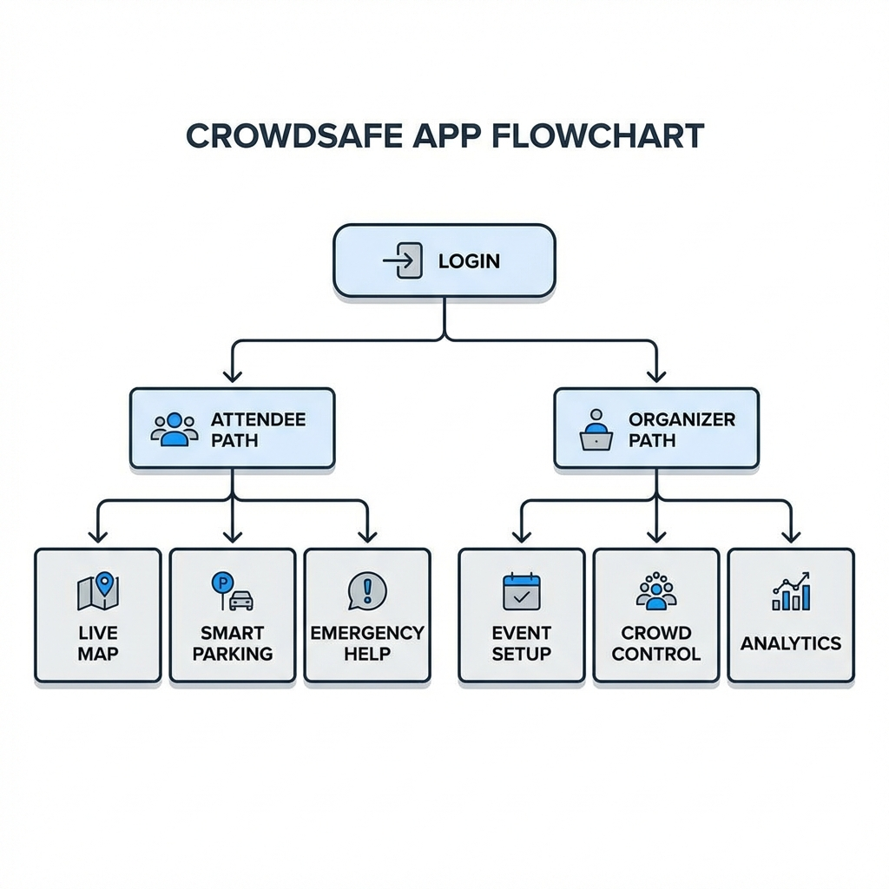
User Flow Diagram
Live map
Event Setup
Parking
Crowd Density on attendee Platform
Crowd Control
Emergency
Analytics
Alerts

Slide 6


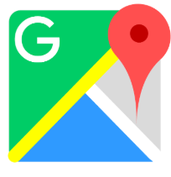

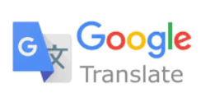




Technical Stacks
Google Technologies Used
REACT
EXPRESS JS
FIREBASE
Google Direction API
Methodologies
Architecture & Design -: Decoupled Frontend & Backend
Styling -: Tailwind CSS
Data & Logic -:
Geospatial Processing - Google Map
Schema Validation – runtime Checking
Deployment & Execution -:
Concurrent Execution Parallel Dev Servers
Cloud-Native Firebase Integration
NodeJS
FIREBASE
Google Direction API

Slide 7
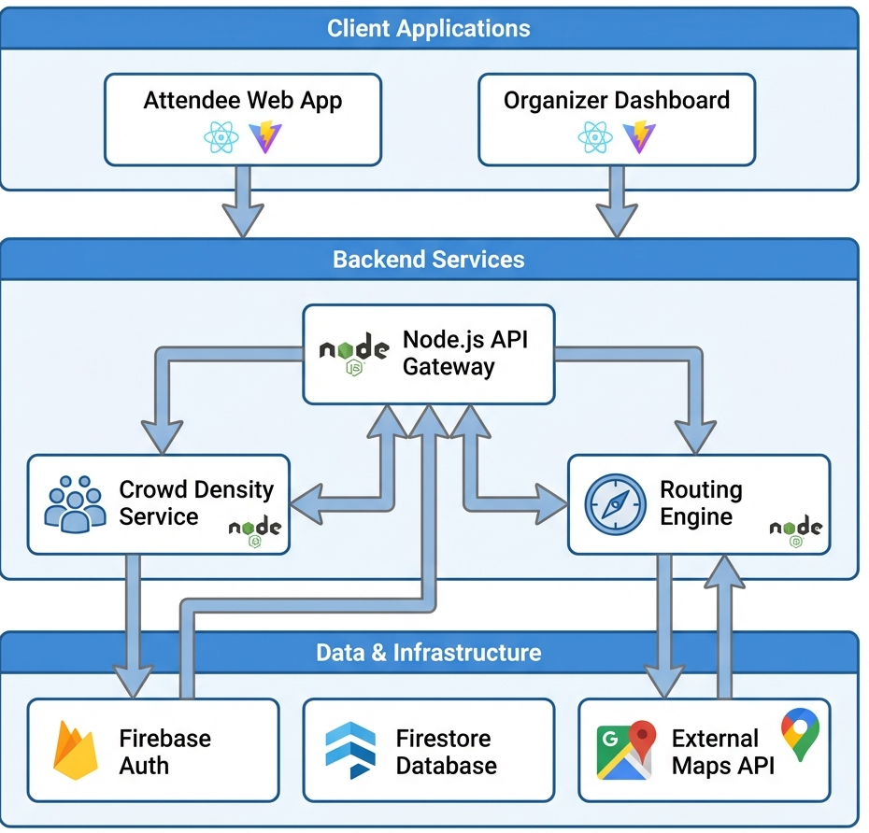
Architecture Diagram
Admin
Authentication
Map Ui/Ux
Event Controller
Crowd Density
APIs
Events
Parking Zones
Users

Slide 8





Feasibility & Revenue of Project
Platform Expenditure
Feasibility Analysis
Features
Pricing (Small Scale)
Pricing (Large Scale)
Technological
Operational
1. Google Maps
Almost Free
5000/- to 15000/- per event
2. FireBase
Almost Free
2000/- to 5000
The platform is reasonably priced constructed with wide open-source tools.
The platform is accessible at any device ( android, ios)
3. Google BigQuery
0/- to 2000/-
10000/-(city level usage)-
4. Cloud Storage
0/- to 5000/-
10000/- to 25000/-
5. Frontend , Backend & Deployment
5000/-
8000/-
Economic
Social
6. Domain Name(one-time)
1350/--
1350/-
One-time cost = 1350/- (approx.)
Monthly cost =>
5000/- to 12000/- (for small Scale event)
30000/- to 50000/- (for large scale event)
Economically Viable (Focus on cost optimization)
Encourages Crowd Management abs their safety

Slide 9
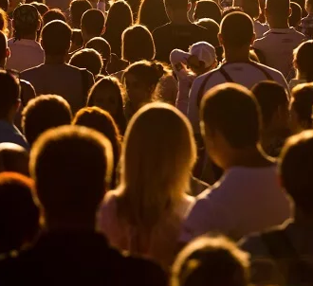



Impact & Benefits
Impact on Target Audience
Challenges V/S Benefits
limits the application to a single server instance
Network
Reducing hazards to many life
Large gatherings notoriously clog cellular networks.
SOCIAL
Scalability
Smooth Travelling
Crowd Controlling
Economical
Platform economically viable to users
Track Individual Movement , high risk for attendee
Easy use of maps
Crowd Density function
Security
Emergency help
Event Management
Provide highly personalized maps
CHALLENGES
TECH-NICAL
Feature like SOS, calls
Map & Parking Creation
Guidance
Reduce Hazards
BENEFITS
Real time Navigation
Alerts & alternative during overcrowding

Slide 10
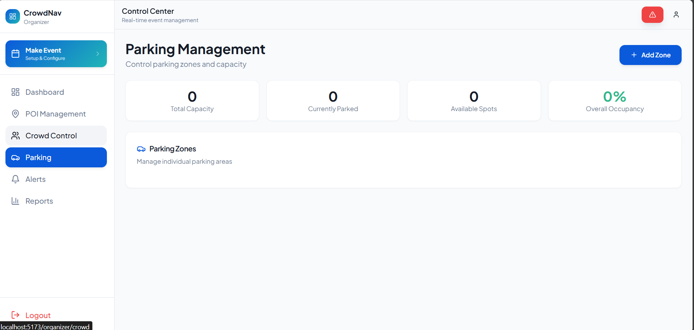
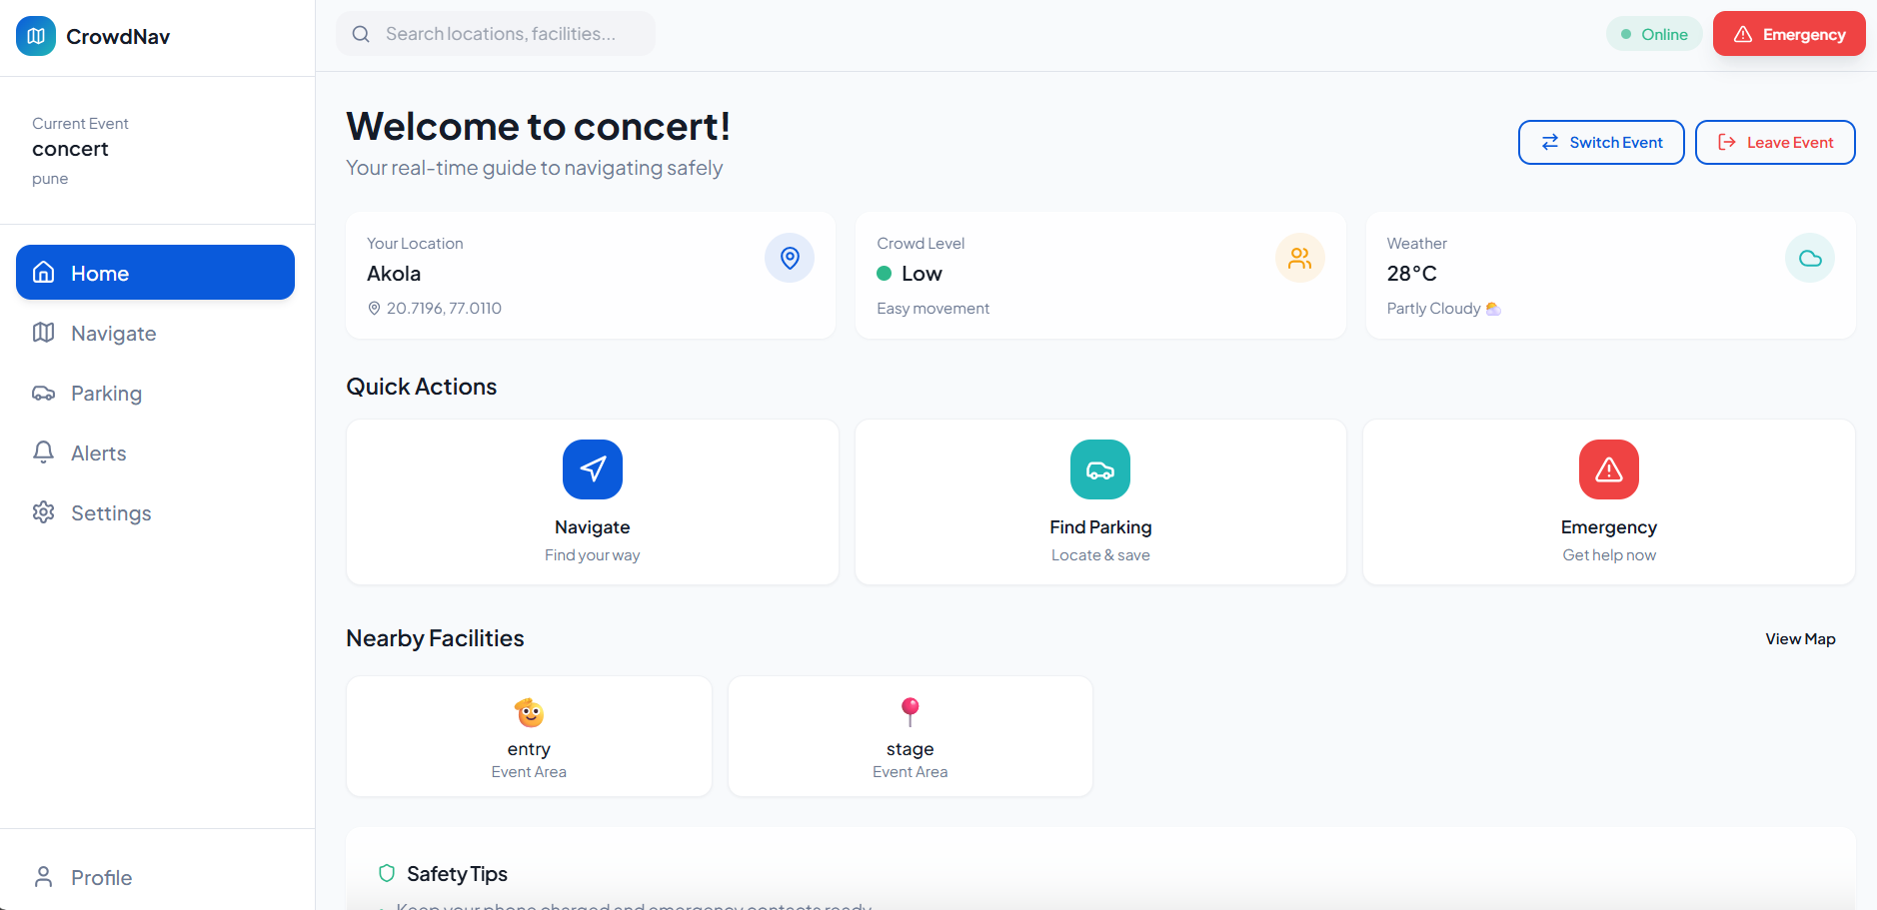
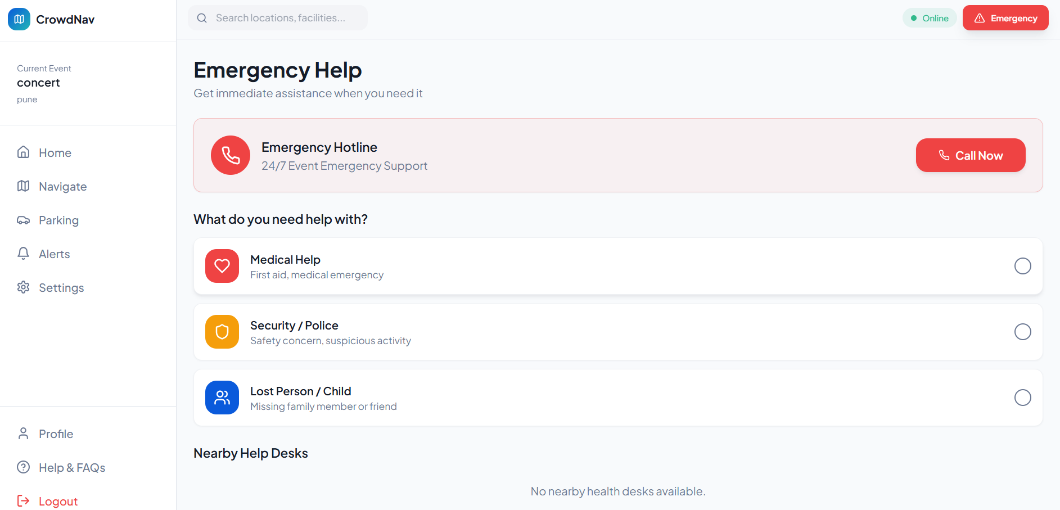
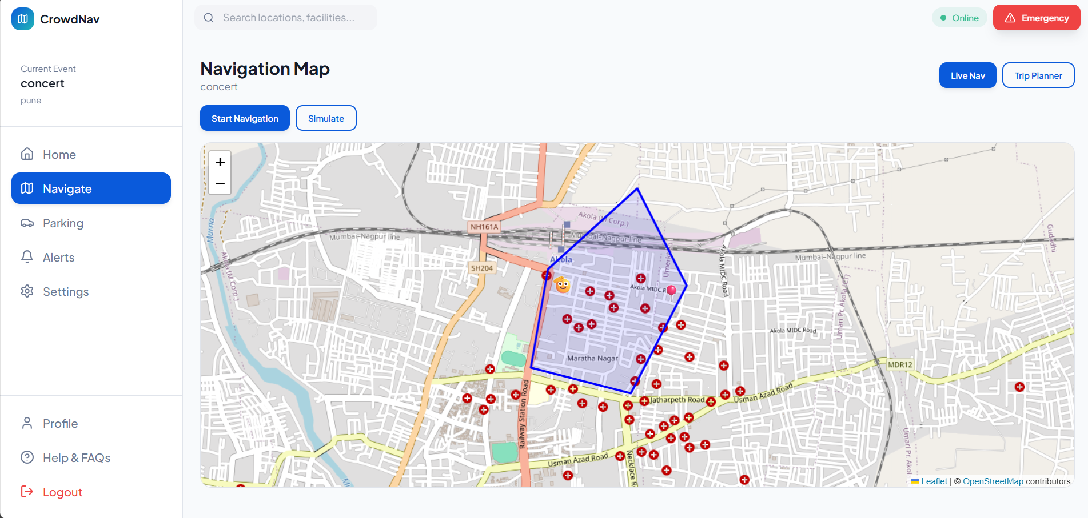
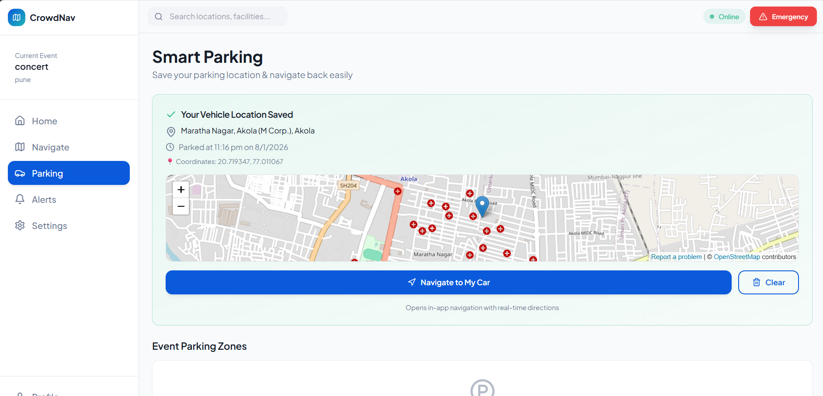
Screenshots of Project

Slide 11
Project Links
1. GitHub Repository-: https://github.com/TitanXS75/VisionAI_SocialTech_GDGoC_GHRCE
2. MVP Link -: https://vision-ai-social-tech-gd-go-c-ghrce.vercel.app/
3. Video Link-: https://youtu.be/Ayz7GnTOpJk

Slide 12
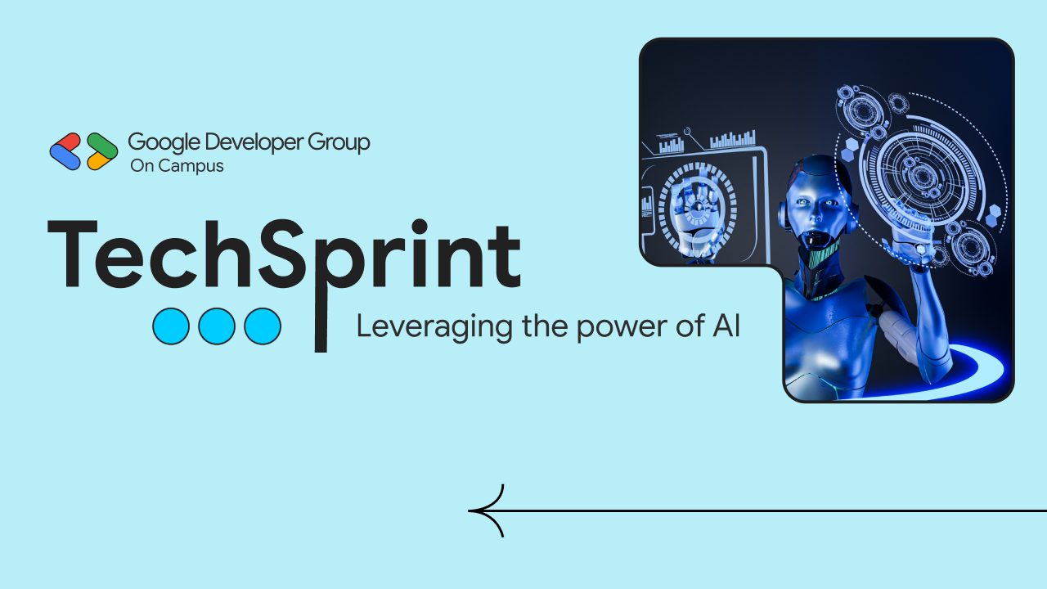
Thank you!

